Slide 1
KRAS G12C Inhibitors Should Not Be Given With Immunotherapy
Gregory J. Riely October 2025

Slide 2
When should we combine drugs?
- pre-clinical evidence to support greater efficacy
- safe when given in combination
- there is clinical evidence of synergy

Slide 3
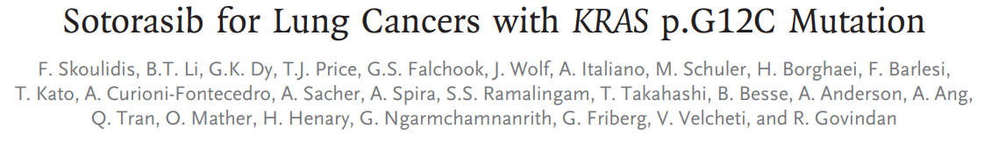
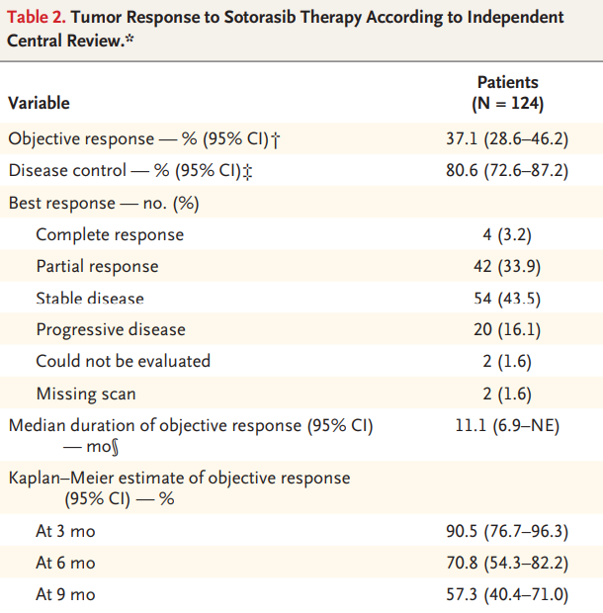
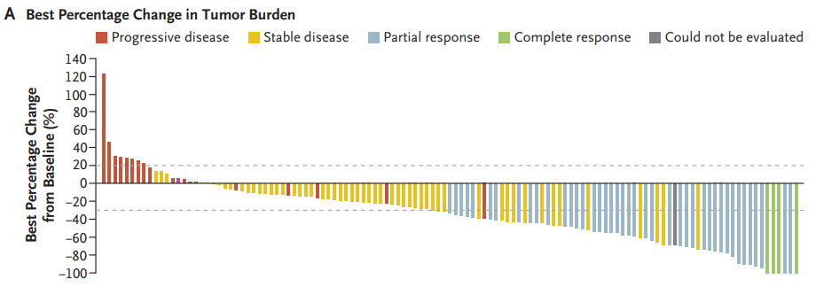
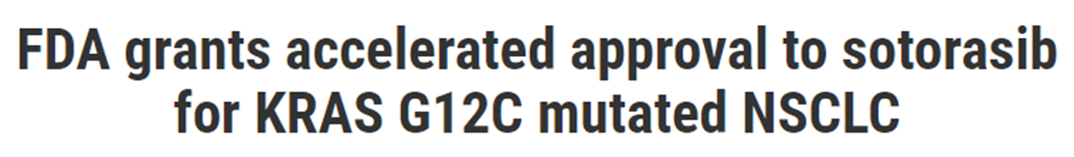
Skoulidis et al, NEJM 2021

Slide 4
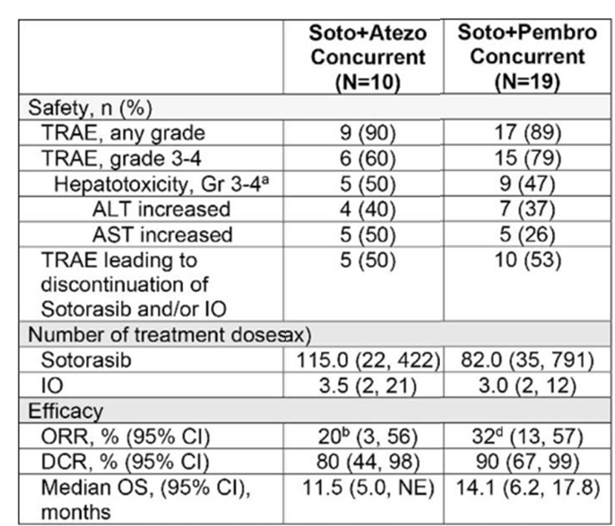
Sotorasib + Immune Checkpoint Inhibitors
Modified from Li et al, WCLC 2022, Vienna

Slide 5
Sotorasib + Immune Checkpoint Inhibitors
CodeBreak 202
sotorasib
Met NSCLC
KRAS G12C
No prior therapy
Pembro
+
Chemo
Modified from Li et al, WCLC 2022, Vienna

Slide 6
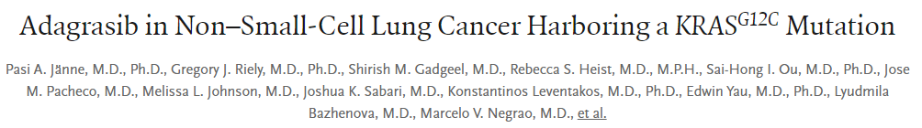
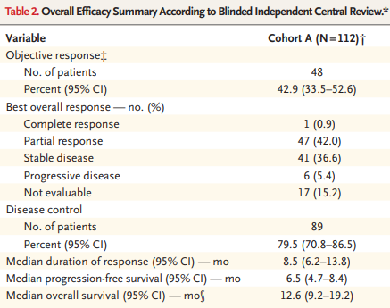
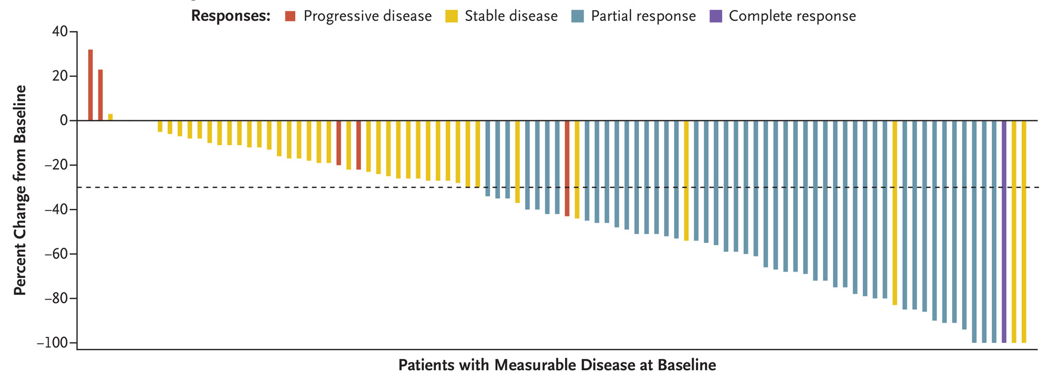
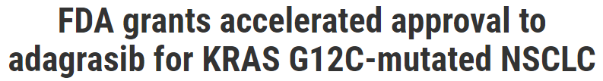
Jänne PA et al. N Engl J Med 2022;387(2):120-31.

Slide 7
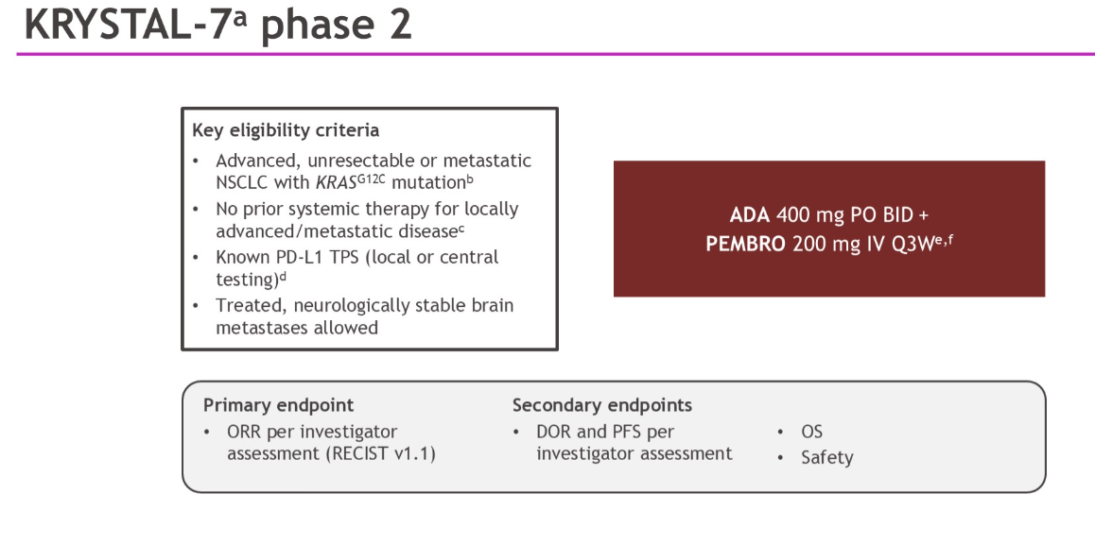
Combining Adagrasib + Pembrolizumab
Janne et al, ASCO 2025

Slide 8
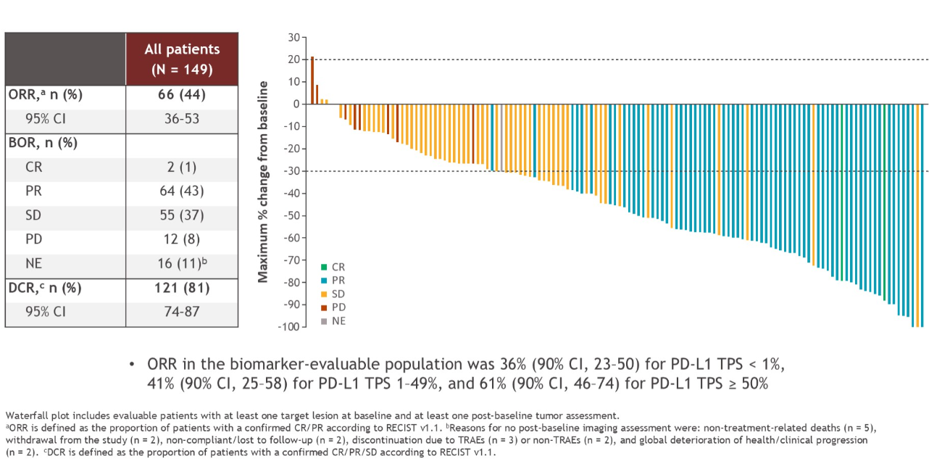
Response Rate of 1st line Adagrasib + Pembrolizumab
Janne et al, ASCO 2025

Slide 9
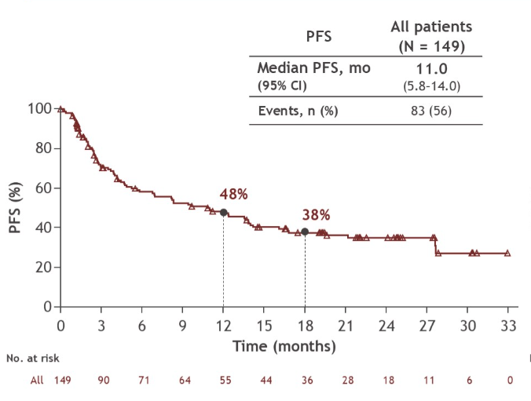
PFS of 1st line Adagrasib + Pembrolizumab
Janne et al, ASCO 2025

Slide 10
NCI definition of synergy: interaction of two or more drugs when their combined effect is greater than the sum of the effects seen when each drug is given alone
 | Adagrasib (2nd line) | Pembrolizumab (2nd line, PD-L1 positive) | Adagrasib + Pembrolizumab (1st line)
Response Rate | 43% | 33% | 66%
mPFS | 6.5 months | 5.3 months | 11 months
Synergy? …I think not
Janne et al, NEJM 2022; Herbst et al, JTO 2021; Janne et al ASCO 2025

Slide 11
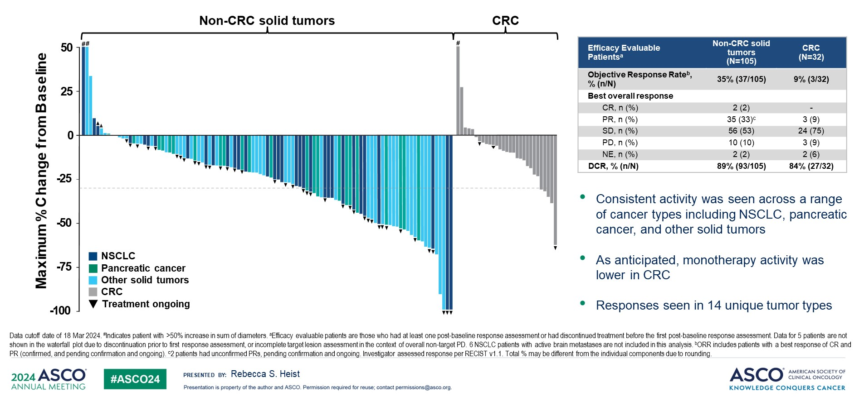
Efficacy in KRAS G12Ci-naïve Solid Tumors <br />(Non-CRC and CRC)
Olomorasib – single-agent
Heist et al, ASCO 2024

Slide 12
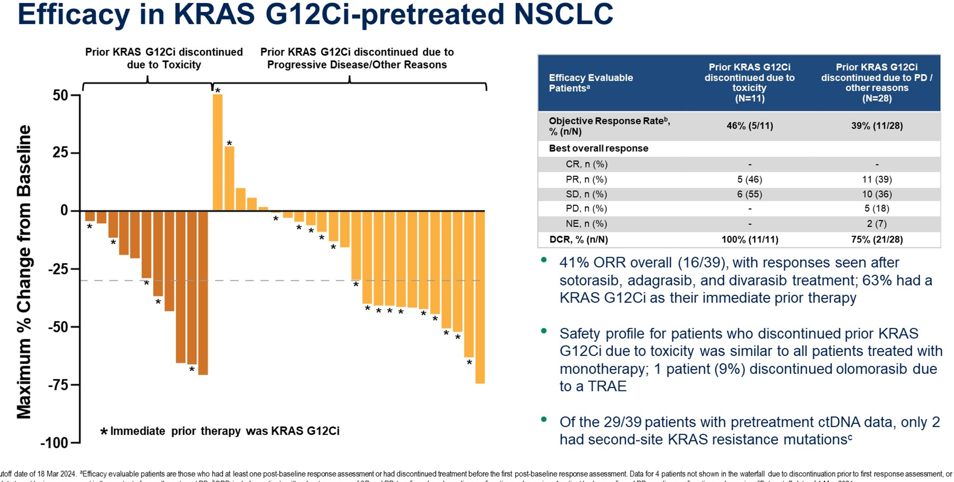
Efficacy in KRAS G12Ci-naïve Solid Tumors <br />(Non-CRC and CRC)
Olomorasib – single-agent
Heist et al, ASCO 2024

Slide 13
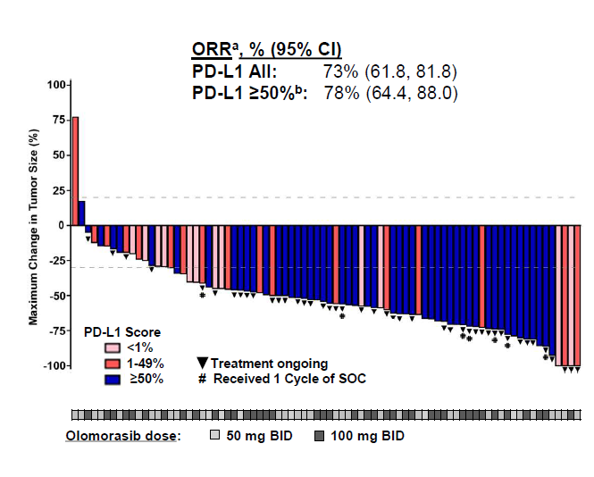
Olomorasib + chemotherapy in first line
Johnson et al, WCLC 2025

Slide 14
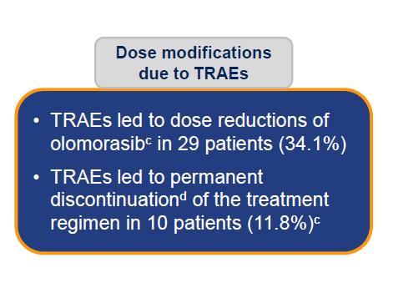
Olomorasib + chemotherapy in first line
Johnson et al, WCLC 2025

Slide 15
Debate Conclusions
Combining KRAS G12C targeted therapies with checkpoint inhibitors increases the toxicity of these agents
There is no clear class effect showing synergy between KRAS G12C targeted therapies and immune checkpoint inhibitors
There may be individual drugs where synergy is present.

Slide 16
Some ongoing trials…
Krascendo 2 – pembrolizumab + divarasib vs pembrolizumab + chemo
Krystal 7 – pembrolizumab + Adagrasib vs pembrolizumab in PD-L1 ≥50%
Sunray 01 – pembrolizumab + olomorasib vs pembrolizumab in PD-L1 ≥50% and chemotherapy/pembrolizumab + olomorasib vs chemotherapy/pembrolizumab in all PD-L1 levels

Slide 17
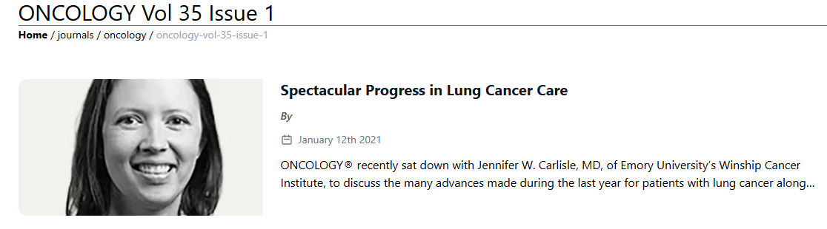
“We really need to do the studies and not assume results.”
--Jennifer W. Carlisle, MD, of Emory University’s Winship Cancer

